Slide 1
GLND Randomization
Once a GLND prospect has been identified start a new Initial Screening Form
DO NOT PRINT OUT AND USE THE FORMS IN THIS PRESENTATION

Slide 2
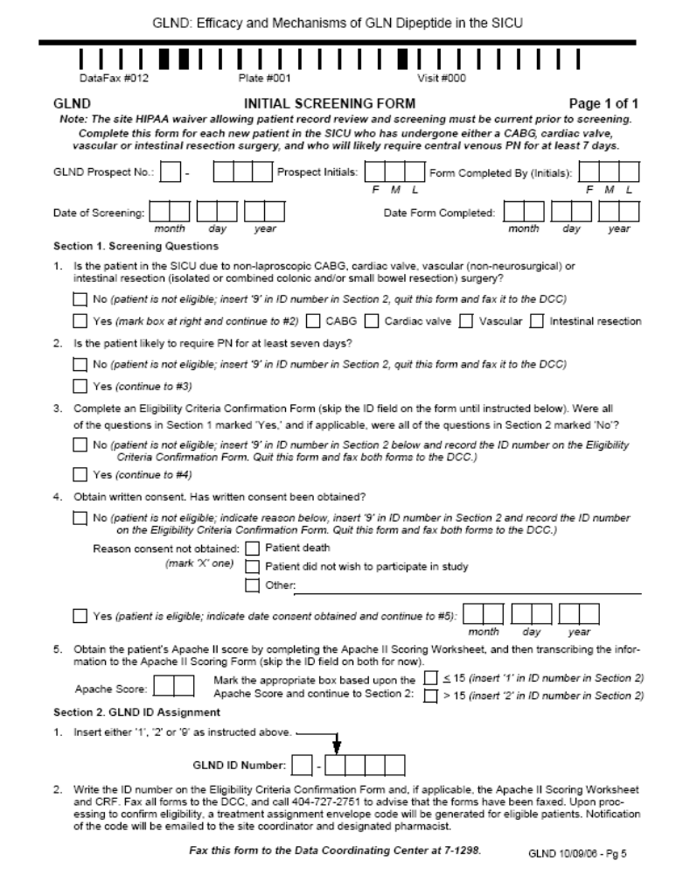

Slide 3
1. Fill out the top section
a) GLND Prospect No.
b) Prospect initials
c) Your initials
d) Date of Screening
e) Date Form Completed
Fill out section 1 – questions 1 and 2
If 1,2 criteria are met, complete an
Eligibility Criteria Confirmation Form

Slide 4
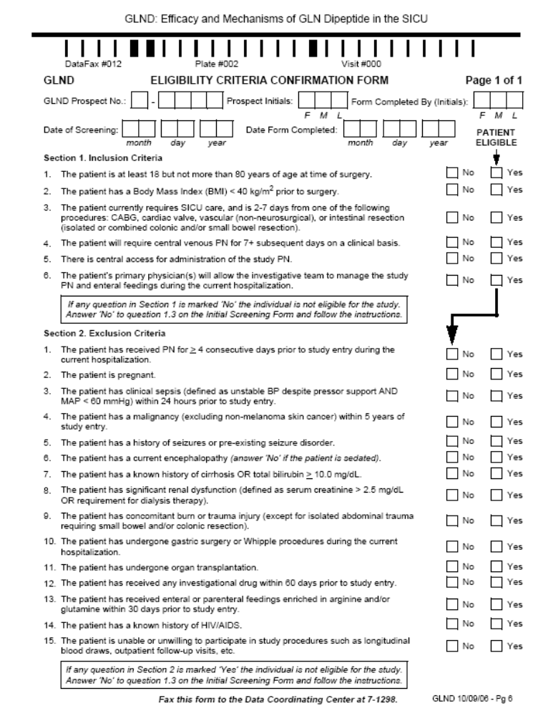

Slide 5
3. Return to Initial Screening Form and fill
out questions 3 and 4. If Informed
Consent is obtained fill out the 4 page
APACHE II Scoring Form. Details on scoring the APACHE II can be found on this DVD in a separate video and PowerPoint presentation. Transcribe the APACHE II score onto question 5 on the Initial Screening Form.

Slide 6
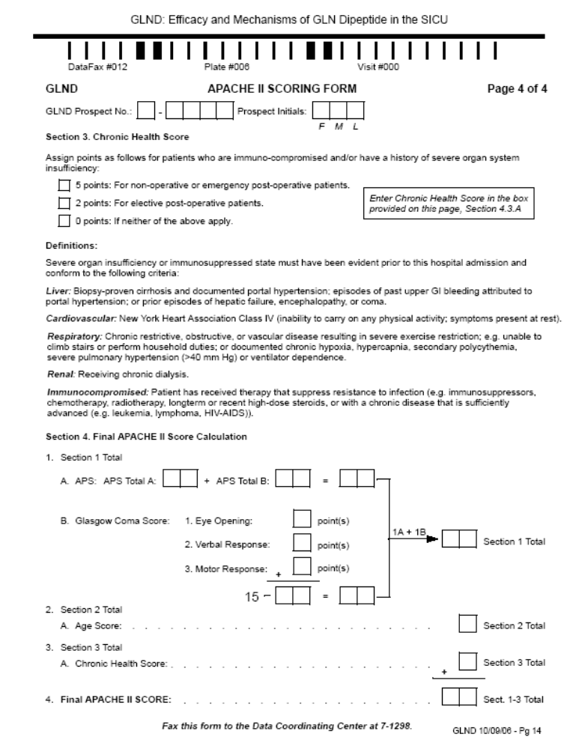

Slide 8
4. Mark the appropriate single box on question 5 and insert either ‘1’ or ‘2’ onto the GLND ID # on
all forms.
5. Fax the 6 pages ( Initial Screening,
Eligibility Criteria Confirmation, and
APACHE II forms ) to the DCC
(Toll Free 866-477-1298 )
6. Call the DCC at 404-727-2751 to advise
that all forms have been faxed.

Slide 9
7. The DCC will process the faxed forms.
If there are any problems, the DCC will
notify you. If ALL the data checks out,
the DCC will fax to the GLND Study
Site Pharmacist and to Susan Rogers the
Treatment Assignment Envelope Code,
and fax to you a Randomization
Acknowledgement (examples of this
fax is provided).

Slide 10
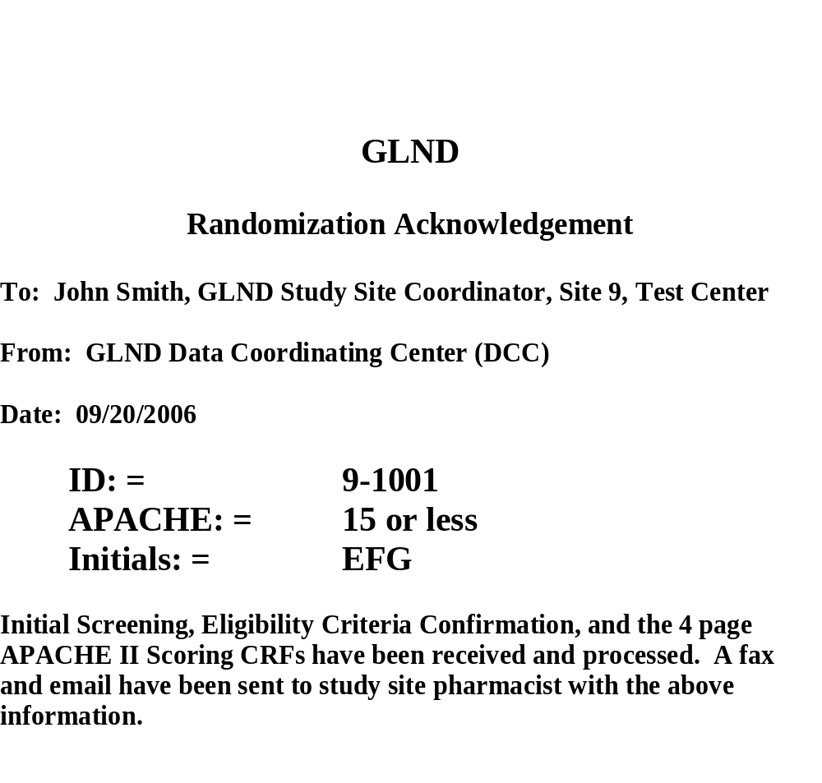

Slide 11
8. This will complete the coordinators part in randomization loop

